Slide 1
FMCG ad -hoc request
By
Naveenkumar

Slide 2
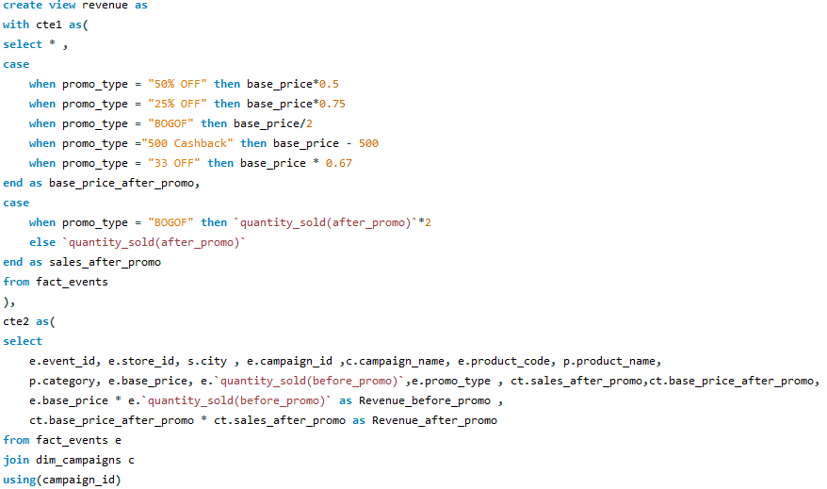
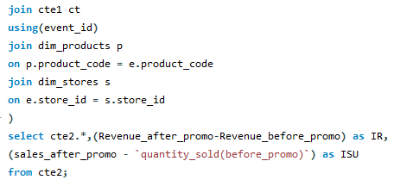
View query

Slide 3
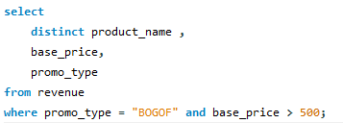


Ad hoc request - 1
Provide a list of products with a base price greater than 500 and that are featured in promo type of “BOGOF”(Buy one get one free). This information will help us identify high value products that are currently being heavily discounted which can be useful for evaluating our pricing and promotion strategies.

Slide 4
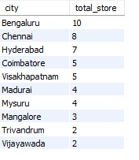
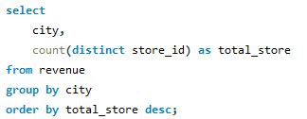
Ad hoc request -2
Generate a report that provides an overview of the number of stores in each city . The result will be sorted in descending order of store counts, allowing us to identify the cities with the highest store presence. The report includes two essential fields: City and store count, which will assist in optimizing our retai operations.

Slide 5
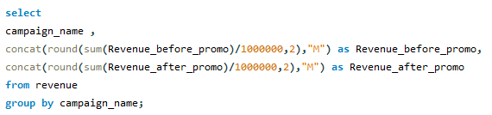

Ad hoc request - 3
Generate a report that displays each campaign along with the total revenue generated before and after the campaign? The report includes three key fields: Campaign_name, total_revenue(before_promo), total_revenue(after promo). This report should help in evaluating the financial impact of our promotional campaigns

Slide 6
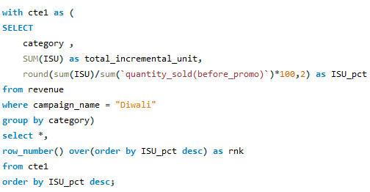
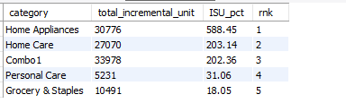
Ad hoc request - 4
Product a report that calculates the incremental sold quantity for each category during Diwali campaign. Additionally provide ranking for the categories based on their ISU% . This report will include three key fields category , ISU% and rank order

Slide 7
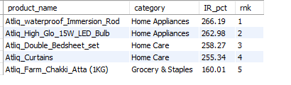
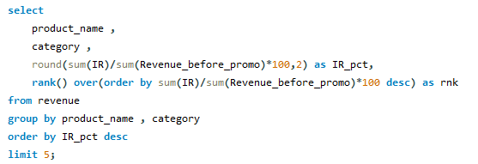
Ad hoc request - 5
5) Create a report featuring the top 5 products ranked by incremental revenue percentage across all campaigns. The report will provide essential information including product_name, category , ir%. This analysis helps identify the most successful products in terms of incremental revenue across our campaigns, assisting in product optimization.

